Slide 1

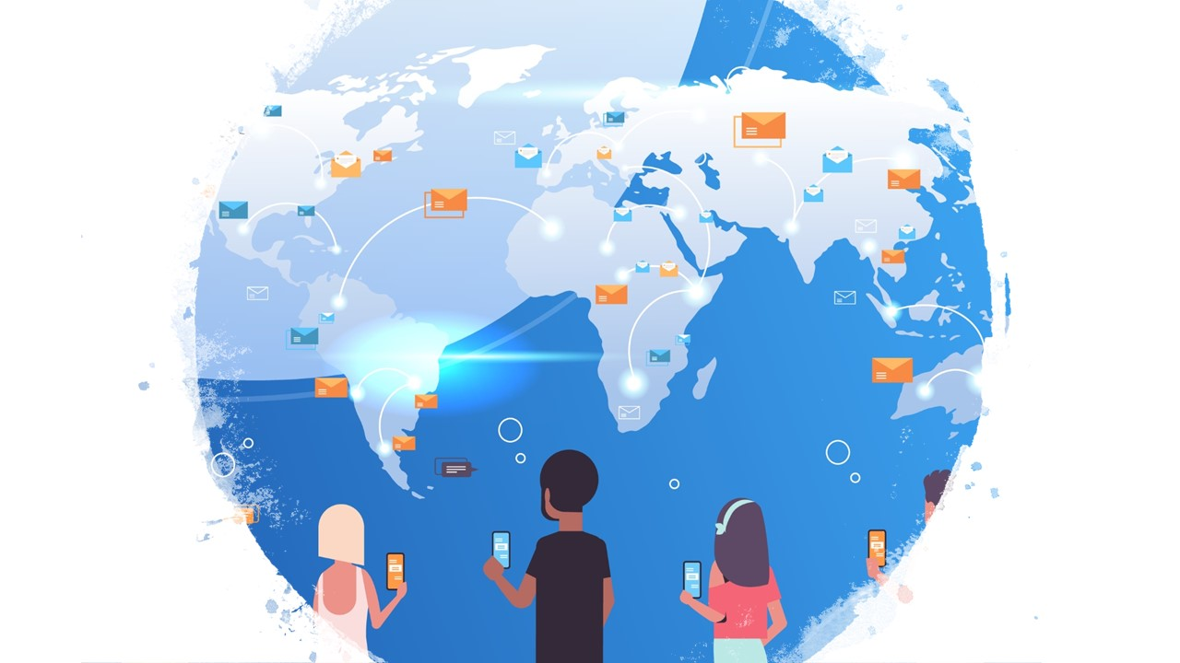
Social Media and Internet Usage
Shilpi Ray
Becky Li
Alexis Fox
Bryce Dudka

Slide 2

Overview
Divided work into three silos:
-Bryce and Becky – get data into database and API
-Shilpi – create interactive graphics
-Alexis – create website
Thought we would be able to combine work streams into usable website without much issue
… but that didn’t super work.

Slide 3
Process step 1 – Data Bryce and Becky
1. Found CSV data! https://data.worldbank.org
-internet connectivity by country
-internet usage per day by country
-social media platform usage by platform
-social media platform usage by gender
2. Convert data to SQLite
online converter https://www.rebasedata.com/convert-csv-to-sqlite-online
3. Use Flask_SQLAlchemy to create data APIs
-we were taught how to load SQL database with postgres, but needed SQLite for sqlalcehmy and flask
-couldn’t read data without primary key, had to add (didn’t need foreign keys, data tables all independent)
-eventually got data working API for all data tables

Slide 4
Process step 2 – Visualization Shilpi
1. Use API to feed data
-modified format for usability
2. Used 3 different JavaScript libraries
-plotly
-canvas
-Apexchart
3. Deployed website in Heroku https://social-netwoking.herokuapp.com/

Slide 5
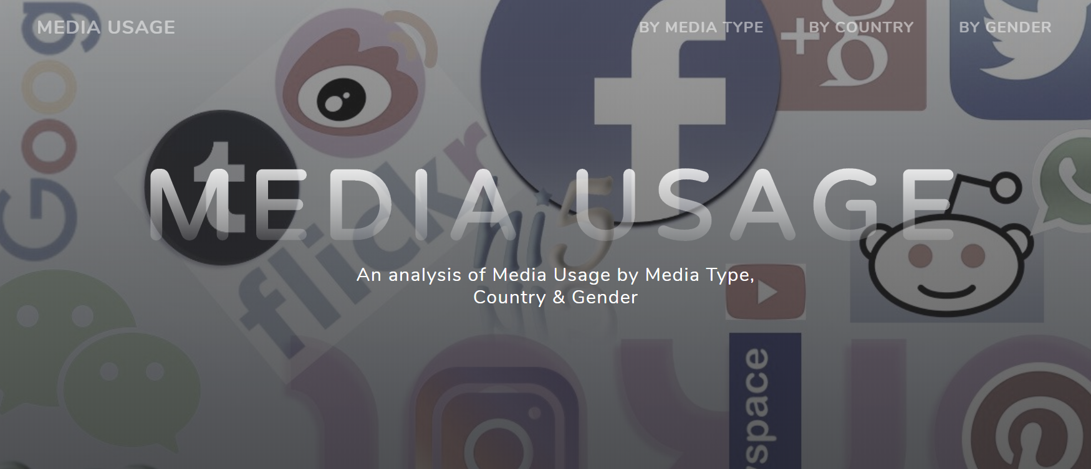
Process step 3 – Website HTML/Bootstrap/CSS
1. Targeted outcome! – Alexis’ fancy and pretty, interactive website

Slide 6
Questions?
Examples:
1. How are you today?
2. Do you have any brothers or sisters?

